Slide 1
Bootloader
Presented by Group 2 !

Slide 2




TEAM MEMBERS
Tran Dinh Bien
Do Ngoc Anh
Nguyen Duc Tung
Do Hoang Nam
Team Leader
Code
Member
Code
Member
Presenter
Slideguy
Code
Member
Code

Slide 3
ASSIGN WORK
1. Tran Dinh Bien
Implement User communicationmain part, main part, GPIO.
General management of progress and implementation work
2. Nguyen Duc Tung
Implement Flash part, bootloader function, slide and present.
3. Do Ngoc Anh
Design and build up application of read temperature from on-boad sensor, send 10 latest value to pc for each received command of 0x55
4. Do Hoang Nam
Implement UART receive File, Parse File Srec.

Slide 4






Light bulb of contents
Our idea
Bootloader
.srec
Memory layout
SREC file
Flowchart
IRL

Slide 5
About Bootloader
01
So, what are we talking about ?

Slide 6
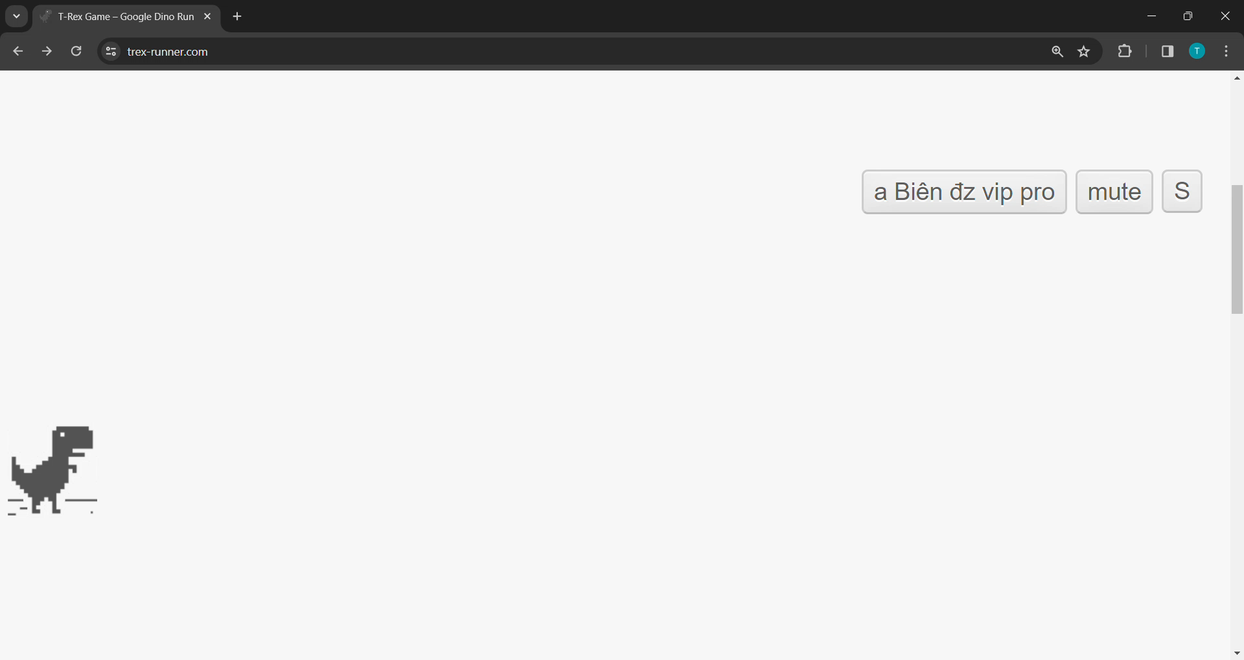
What is Bootloader ?
Bootloader is a special software that is loaded into the computer’s memory before booting.
If there is a Bootloader program loaded into the microcontroller, it will first jump into this Bootloader program, do some work and then switch to the application program to execute.
Application
Bootloader
…

Slide 7


So, why do we need Bootloader ?
Update Firmware
Enable to update wirelessly without going to store to reload the Firmware
Security
Can insert some code to check if the loaded Firmware is correct or not. If not valid, the update will not be allowed

Slide 8
02
Our idea
Which option did we choose ?

Slide 9
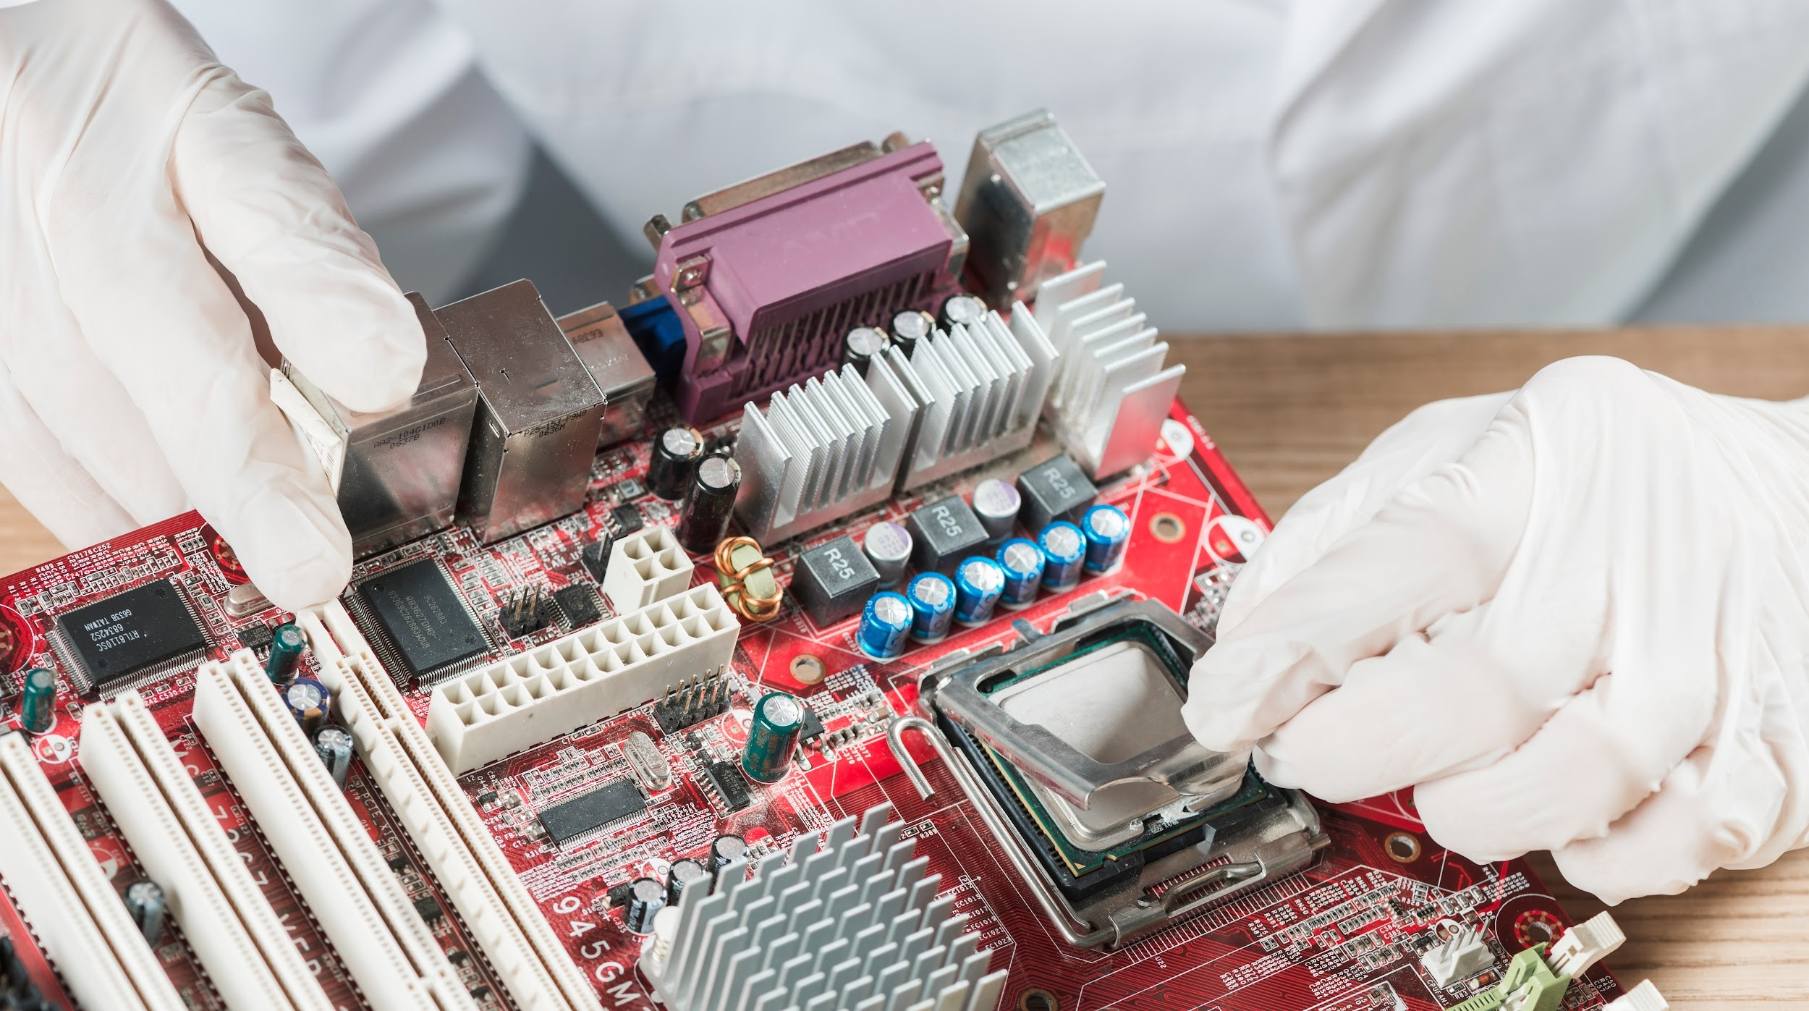
Board : MKE16Z64 of NXP Chip : ARM Cortex M0+ Software: MCUXpresso IDE Hercules
Hardware & Software

Slide 10

Firmware
Bootloader Mode
Application Mode
Execute User command
Add new App
Erase old App
Load selected App
Run Current App
Default : Blink LED
App 1 : Read Temperature Sensor
App 2 : Control LED with button

Slide 11
Memory layout
03
Where to store code & data ?

Slide 12
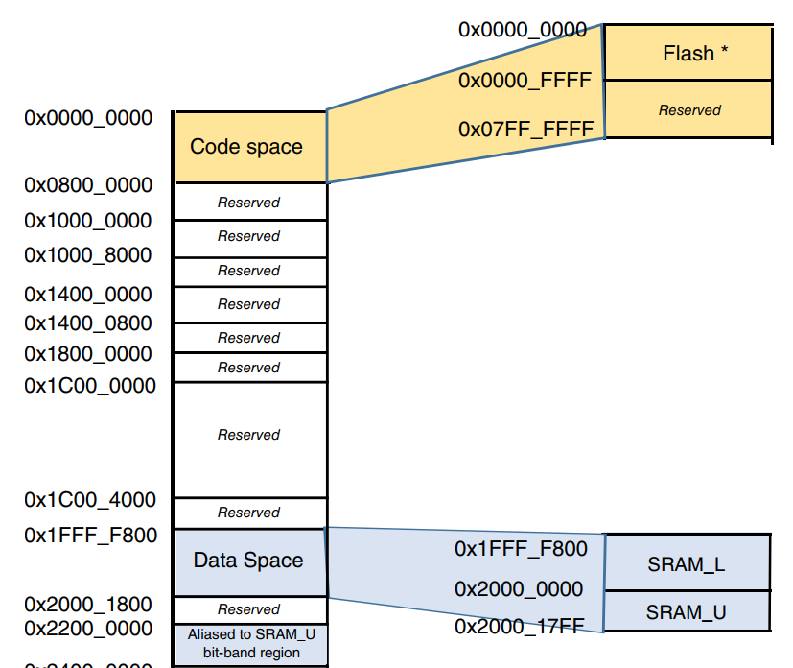
MKE16Z64 memory layout
01
02
Flash memory
Used to store program code and commands ( MSP, Vector Table … )
This device contains 1 block (64 KB) of program flash consisting of 1 KB sectors starting at address 0x0000_0000
- Divided into 64 sectors
- Write in Word (4 bytes)
- Erase by Sector
SRAM memory
Used to store temporary data during run-time
The on-chip SRAM is split into SRAM_L and SRAM_U regions anchored at address 0x2000_0000
SRAM_L size : 2 KB
SRAM_U size : 6 KB

Slide 13
SREC file
04
Structure & Style

Slide 14
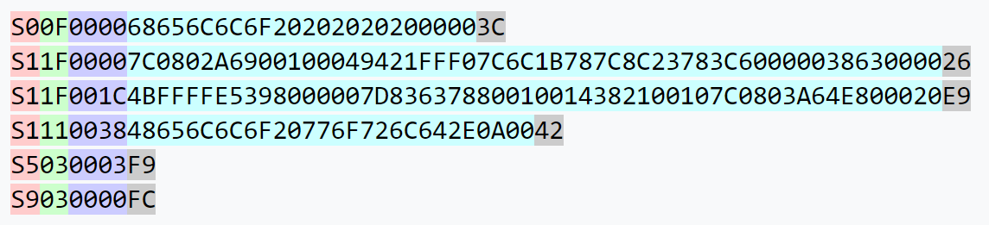
SREC file structure
S19-style 16-bit address records
Header
Data
End

Slide 15
Flowcharts
05
Easy to follow

Slide 16
Main flowchart
Reset
Jump to address 0x0000_0000
Main() function
SW3 is held ?
T
Bootloader Mode
Add / Erase / Load ?
F
Application Mode
Jump to Current App
Application code
Soft Reset
Super Loop

Slide 17
Bootloader Mode flowchart
Start
Receive Command via UART
F
Command valid ?
Add ?
T
Receive SREC file via UART
Write to Flash
T
Erase the sector containing Erasing App
Erase ?
Load ?
T
Set Current_App_Address = Loaded_App_Address
Reset
End

Slide 18
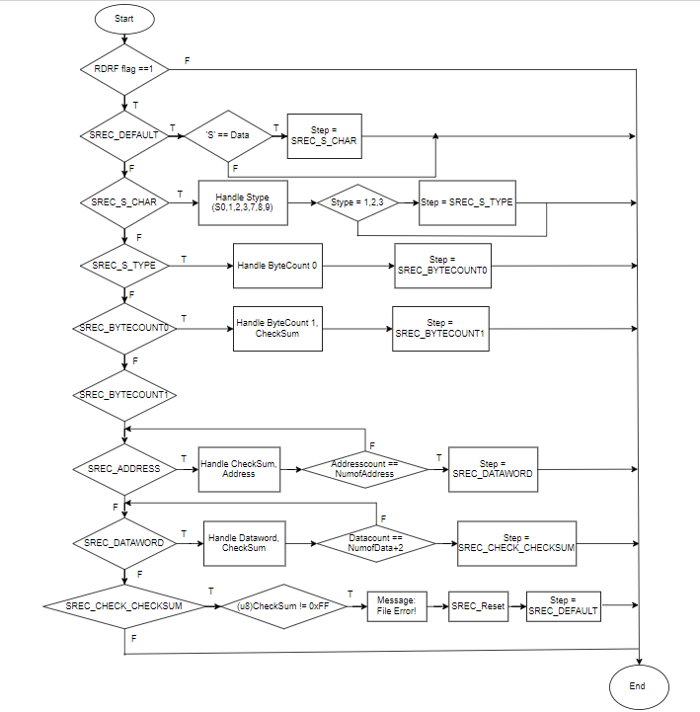
Parse SREC file flowchart

Slide 19
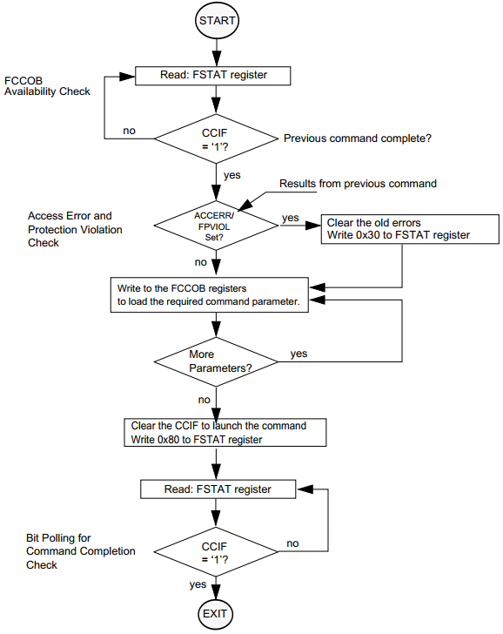
Flash command write sequence flowchart

Slide 20
Bootloader() function flowchart
Start
Get address to jump to
APP_START_ADDRESS = Current_App_Address
Disable all interrupts
__disable_irq();
SysTick->CTRL = 0;
Set SCB->VTOR
Set Main Stack Pointer
Set Program Counter
SCB->VTOR = APP_START_ADDRESS;
__set_MSP(*((volatile u32*) APP_START_ADDRESS);
pFunction_t JumptoApp = (pFunction_t)(*((volatile u32*)(APP_START_ADDRESS + 4)));
Jump to App
JumptoApp();
End

Slide 21
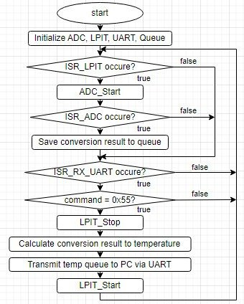
Application flowchart

Slide 22
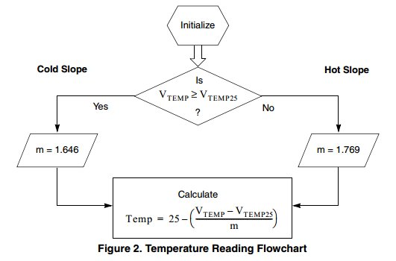
Configure ADC module
Input clock = 1 MHz
Internal clock ADC = 1/8 MHz
ADC resolution = 10 bit
ADC channel = temp sensor channel
Note
m is the hot or cold voltage versus temperature slope in V/°C
Vtemp is the voltage of the temperature sensor channel at the ambient temperature
Vtemp25 is the voltage of the temperature sensor channel at 25°C and VDD = 3 V

Slide 23
Calculation example
Vtemp = Vtemp * 0.003125 ; // Convert the ADC reading into voltage if (Vtemp => 0.7012) // Check for Hot or Cold Slope
{ Temp1 = 25 – ((Vtemp – 0.7012) / 0.001646); // Cold Slope }
else
{ Temp1 = 25 – ((Vtemp – 0.7012) / 0.001749); //Hot Slope
}
Note: VDD = 3.2 volts for the VTEMP conversion

Slide 24
IRL
06
Let’s him cook !!!

Slide 25
Resources
Here’s the reference resources for this project:
Bootloader: https://www.laptrinhdientu.com/2021/10/Bootloader1.html
Board KE16: KE16’s Reference Manual
SREC file: https://en.wikipedia.org/wiki/SREC_(file_format)
Special thanks to our teacher:
Nguyen Van Nghia

Slide 26
Thanks!
Do you have any questions?
Muốn nắm chắc kiến thức thì phải học Vậy học như nào để nắm được tay em :(((

